Slide 1

Part 4: Feed
(IoT Activity Kit)
by NETPIE.io

Slide 2
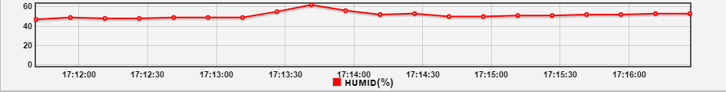
Feed
NETPIE provides Feed for Time series data collected from sensors

Slide 3


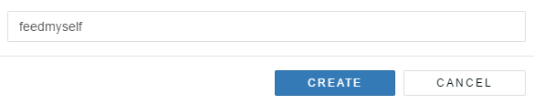
Create : Feed
1 go to ->https://netpie.io/feed or
https://netpie.io go to menu-> RESOURCES --> FEEDS
2.Click at Icon
3.fill Feed name and click

Slide 4
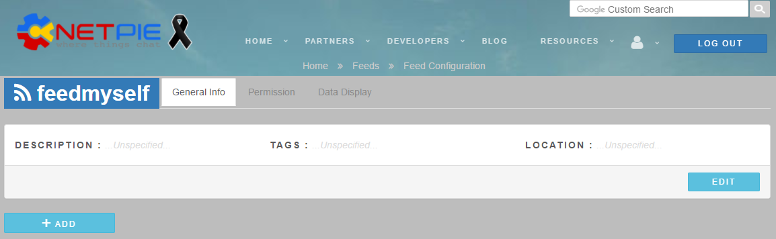
Create : Feed
General menu
Menu for Feed-permission
Menu for data display
tag Feed
Add data in Feed
Feed location setting
Feed information

Slide 5

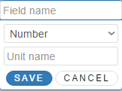
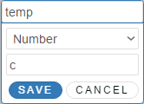
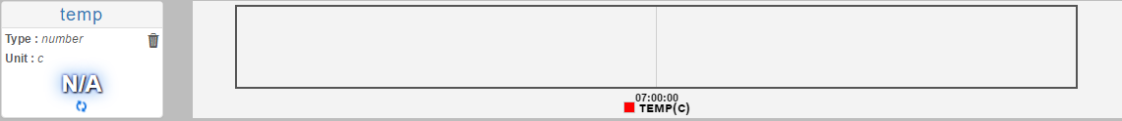
Create : Feed
4.add Field
5.fill Field name, Unit name เสร็จแล้วกด SAVE

Slide 6
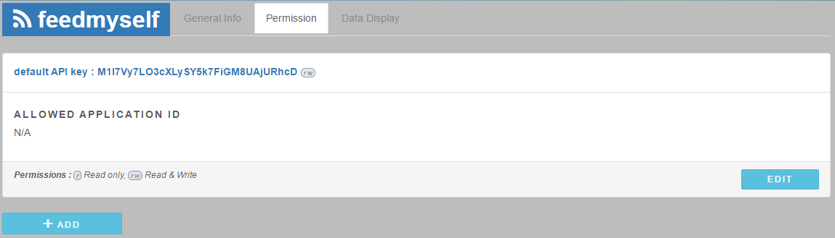
Permission
Default API Key using for Feed Permission
Edit permission
Set Application ID for Feed

Slide 7
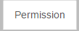
Permission
Feed Permission menu
1.use API Key

Slide 8
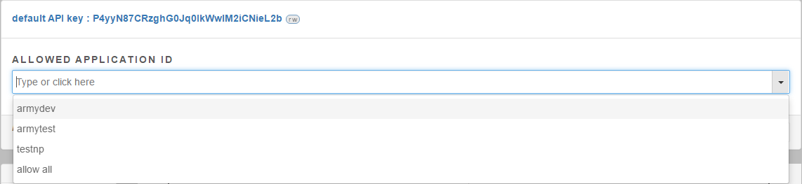

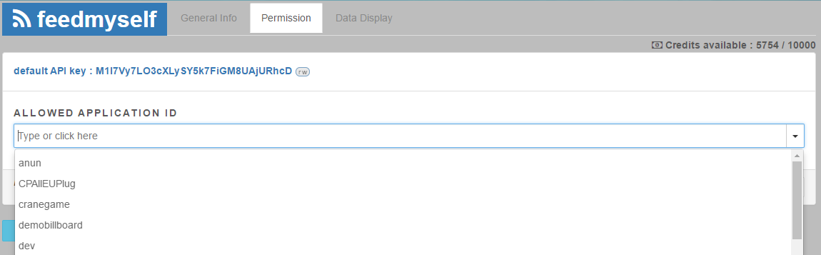
Permission
2.AppID permission
Click then click to choose AppID or choose allow all for every AppID permission
Click to save Feed condition

Slide 9
Write : save data in Feed
There are 2 methods to save data in Feed
1.use REST API
$ curl -X PUT "https://api.netpie.io/feed/FEEDID?apikey=APIKEY&data=DATA"
EX: DATA
DATA=data1:value1,data2:value2
2.use Microgear Function
microgear.writeFeed("FEEDID","DATA")
microgear.writeFeed("FEEDID","DATA","APIKEY")
FEED ID
Data in json format
Default API Key

Slide 10
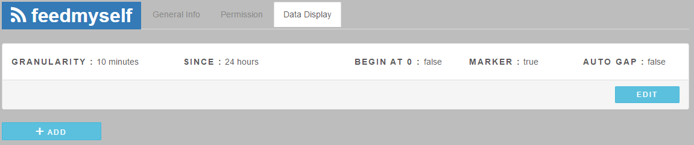
Data Display
Average data every 10 min
TRUE: start Y at 0
FALSE Y is averaged data
Data display range
AUTO GAP : TRUE
AUTO GAP : FALSE

Slide 11
Read : Export data from Feed
FEED ID
Default API Key
To export data
1.use REST API
https://api.netpie.io/feed/FEEDID?apikey=APIKEY&granularity=GRANULARITY&since=SINCE&filter=FILTER
Ex:
https://api.netpie.io/feed/piesensor?apikey=APIKEY&granularity=15minutes&since=8hours&filter=temp,humid
2.use Feed บน Freeboard
Starting time
Filtered data

Slide 12

Read : Export data from Feed
3.Use Feed on https://netpie.io/feed
Click then click
modify config to display data
GRANULARITY
BEGIN AT 0 = TRUE Y begin at 0
MARKER
AUTO GAP fill gap automatically
Click

Slide 13
Lab Feed
NETPIE_L04_FEED.ino
..
#define FEEDID "FEEDID" // ใส่ชื่อของ FEEDID
#define FEEDAPI "FEEDAPI" // ใส่ API ของ FEED
..
unsigned long lastTimeWriteFeed = 0;
..

Slide 14
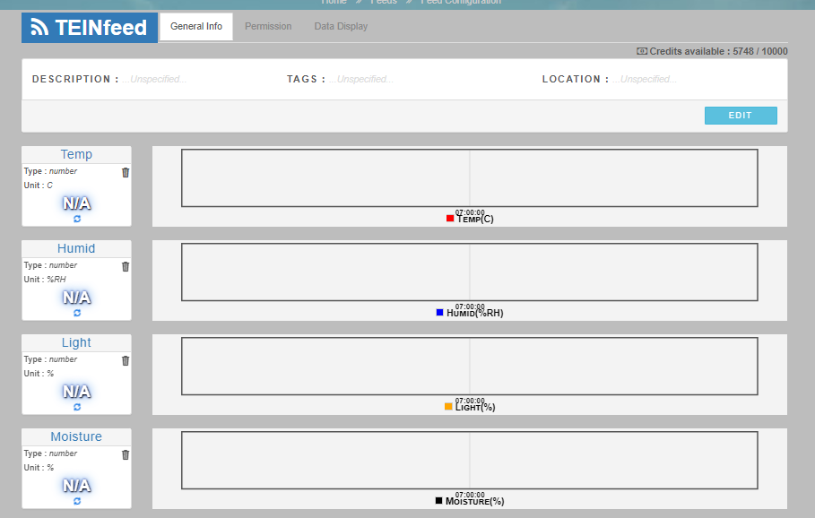
Feed
if(millis()-lastTimeWriteFeed > 15000){
lastTimeWriteFeed = millis();
if(humid!=0 && temp!=0){
String feeddata = "{\"Humid\":";
feeddata += String(currentHumid) ;
feeddata += ", \"Temp\":";
feeddata += String(currentTemp);
feeddata += ", \"Light\":";
feeddata += String(currentLight);
feeddata += ", \"Moisture\":";
feeddata += String(currentMoisture);
feeddata += "}";
Serial.print("Write Feed --> ");
Serial.println(feeddata);
netpieshow("Send to FEED->...");
//microgear.writeFeed(FEEDID,feeddata);
microgear.writeFeed(FEEDID,feeddata,FEEDAPI);
}
}

Slide 15
Lab Feed (ต่อ)
if(millis()-lastTimeWriteFeed > 15000){
lastTimeWriteFeed = millis();
if(humid!=0 && temp!=0){
String data = "{\"humid\":";
data += humid;
data += ", \"temp\":";
data += temp;
data += ", \"light\":";
data += light;
data += "}";
Serial.print("Write Feed --> ");
Serial.println(data);
if(FEEDAPI!="") microgear.writeFeed(FEEDID,data,FEEDAPI);
else microgear.writeFeed(FEEDID,data);
}
}
data
{"humid":49.56, "temp": 24.37, "light": 1}

Slide 16
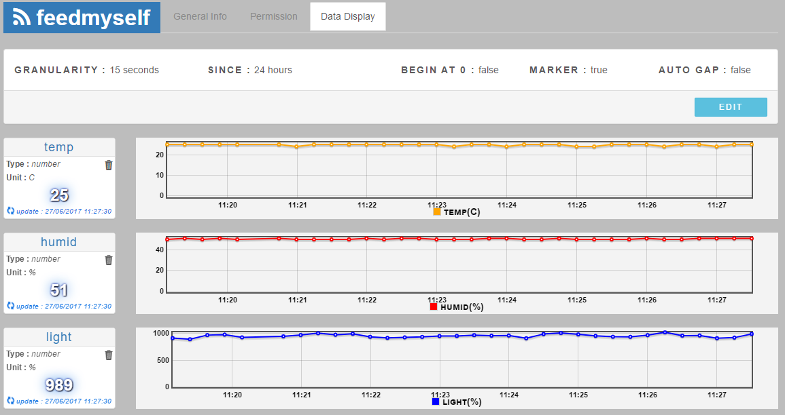
Lab Feed (ต่อ)
Fill Field temp, humid and light in Feed
Set AppID permission

